Slide 1





Engineering Economics
Russia and Ukraine war impact on global economy;
A Closed eye view on Bangladesh economy

Slide 2
Info
Khondokar Saim
Hasnat Zamil
221902353
221902001
Sochocho Kumar Roy
Md. Sumon Mia
213902121
221902154

Slide 3
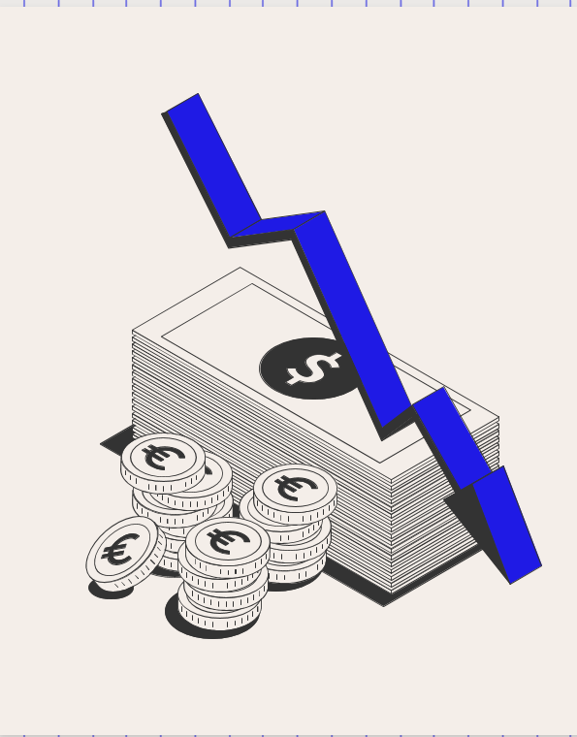

Table of contents
01.
02.
03.
04.
05.
Russia-Ukraine Conflict: Background and Overview
Economic Consequences for the USA and UK
Analyze the economic connections between South Asia
and the nations that are afflicted by the Russia-Ukraine
war.
Investigate how the conflict has impacted global
energy markets,
Russia vs Ukraine War: Impact on Bangladesh’s Economy

Slide 4

01. Russia-Ukraine Conflict: Background and Overview
The conflict between Russia and Ukraine started in 2014.
Russia took control of Crimea, a region that was previously part of Ukraine.
This happened after protests in Ukraine against their president's decision to align with Russia instead of the European Union.
Many countries condemned Russia's annexation of Crimea.
Pro-Russian separatists in eastern Ukraine declared independence and wanted to join Russia.
The Ukrainian government fought against the separatists to regain control.
Russia has been accused of supporting the separatists with weapons and soldiers.
The conflict caused a lot of fighting and casualties.
Many people had to leave their homes because of the violence.
Multiple attempts at ceasefires have failed, making it hard to find a peaceful solution.

Slide 5
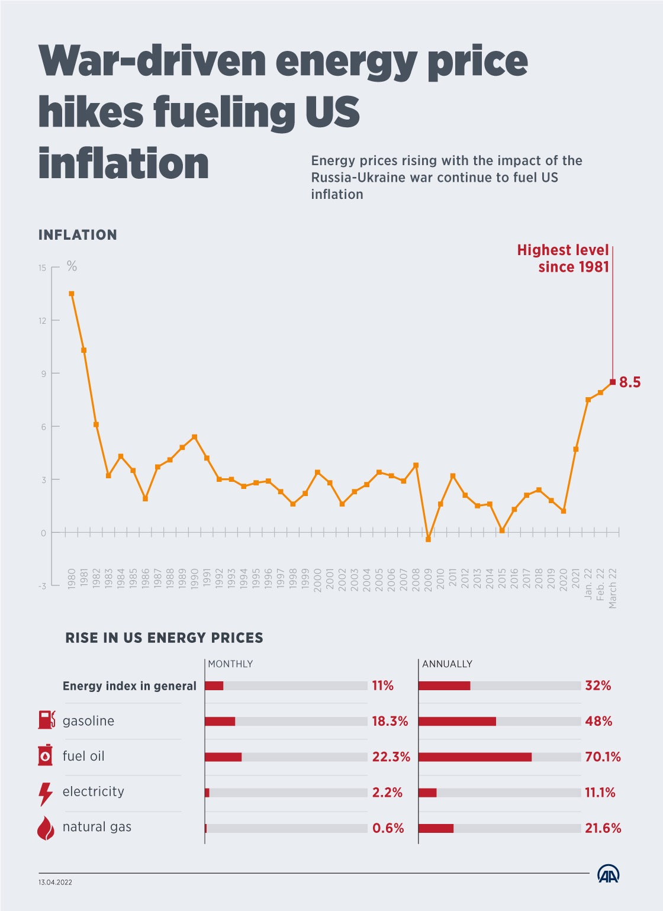
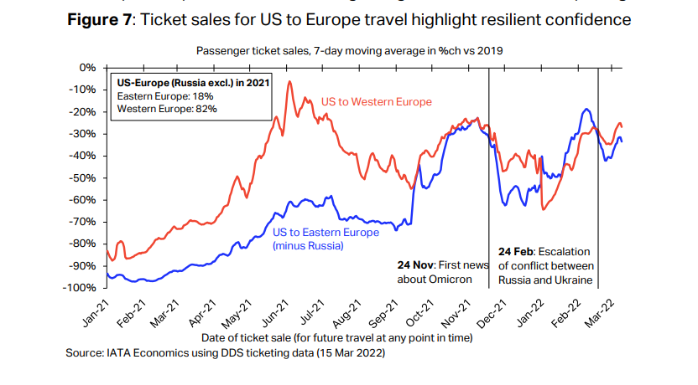
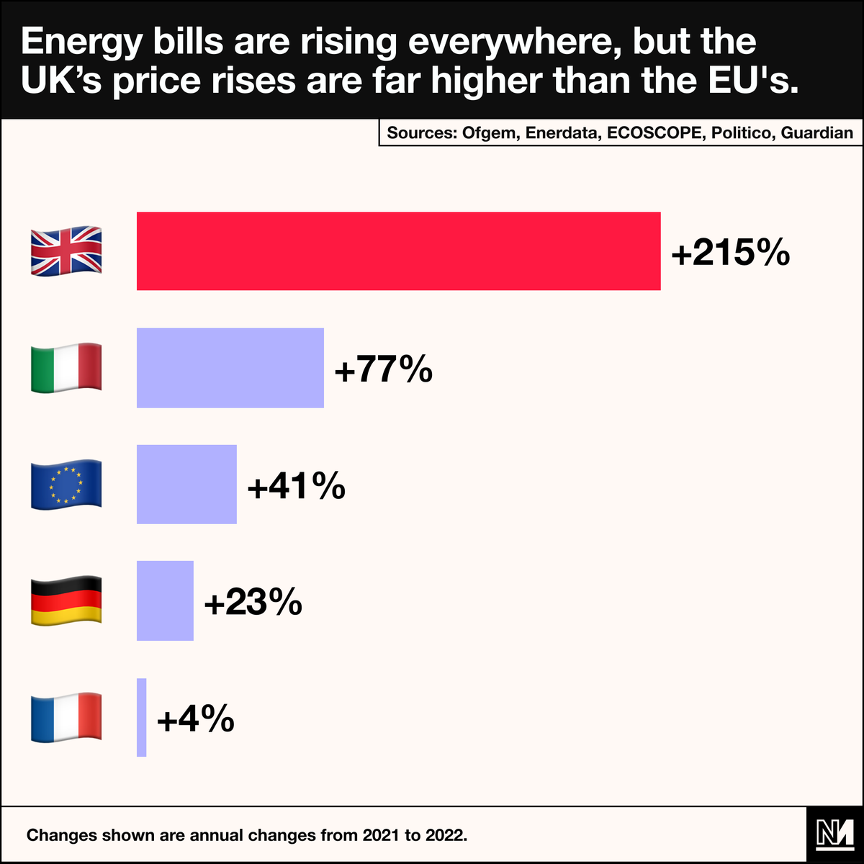
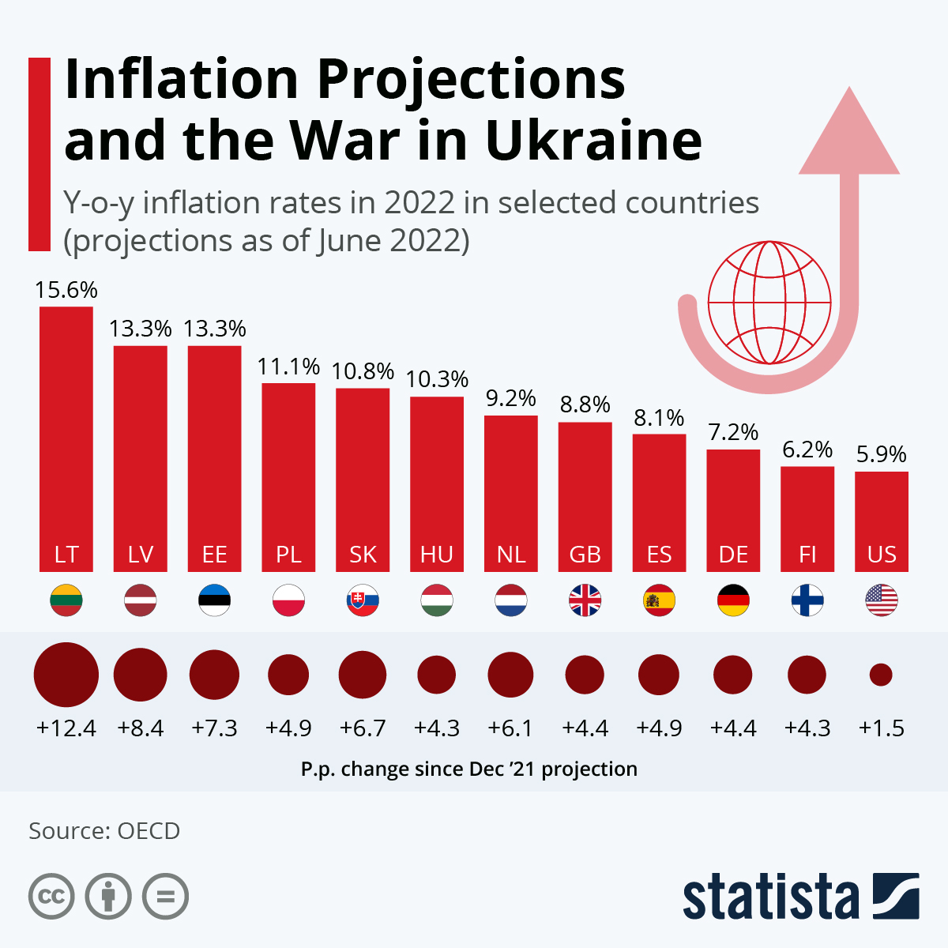
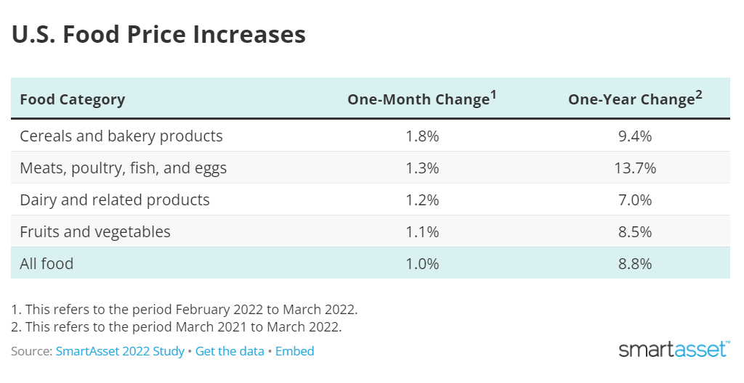
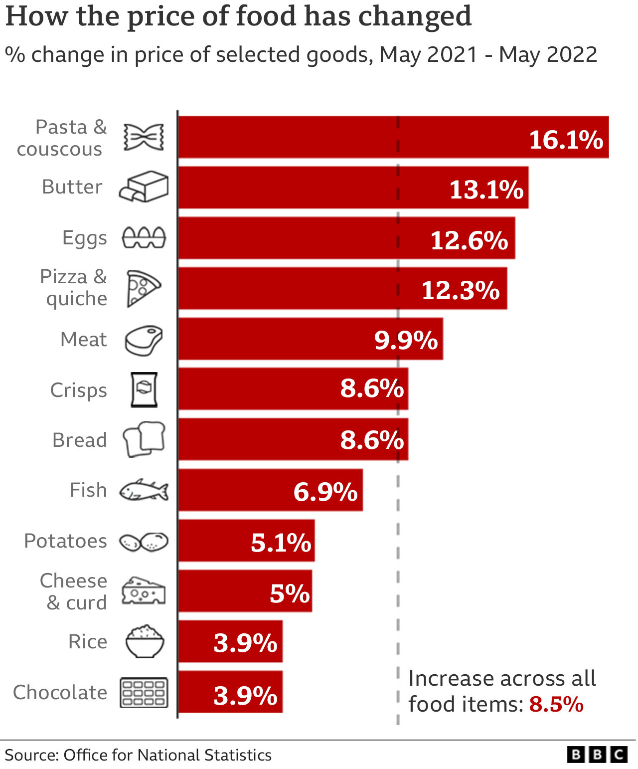
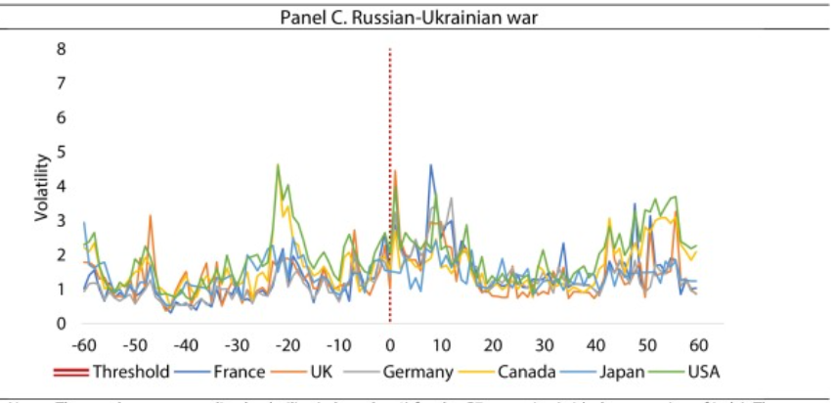
02. Economic Consequences for the USA and UK.
The economic consequences of the Russia-Ukraine conflict have been significant for both the USA and the UK
Energy and oil prices rise
Supply chain issues for farmers could drive higher food prices
Travel restrictions and rising airfare costs
Stock market volatility
A Continued Inflation

Slide 6
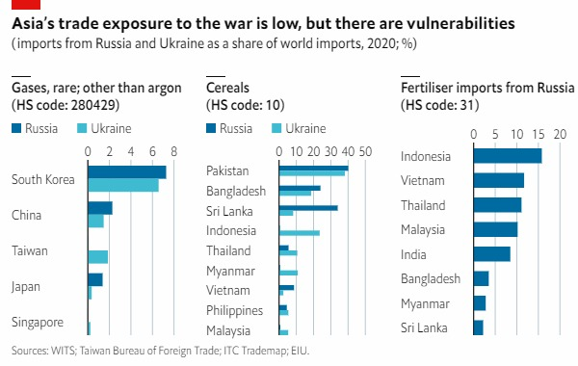
04. Analyze the economic connections between South Asia and the nations that are afflicted by the Russia-Ukraine war
Infrastructure Development:
South Asian expertise in infrastructure can contribute to post-war reconstruction efforts.
Technological Innovation:
Collaboration in cybersecurity, AI, and advanced weaponry drives economic growth.
Regional Integration:
South Asia can facilitate economic connectivity and unlock immense potential.
Trade Diversification:
South Asia offers new markets for affected nations to diversify trade relations.
Energy Partnerships:
South Asia provides a stable energy market and investment opportunities for nations with energy reserves.
In conclusion, South Asia offers new trade markets, stable energy opportunities, expertise in infrastructure development, and potential for technological innovation and regional integration. These factors make the region attractive for nations seeking diversification, investment, and economic growth.
Notes:
DM Sans Medium

Slide 7
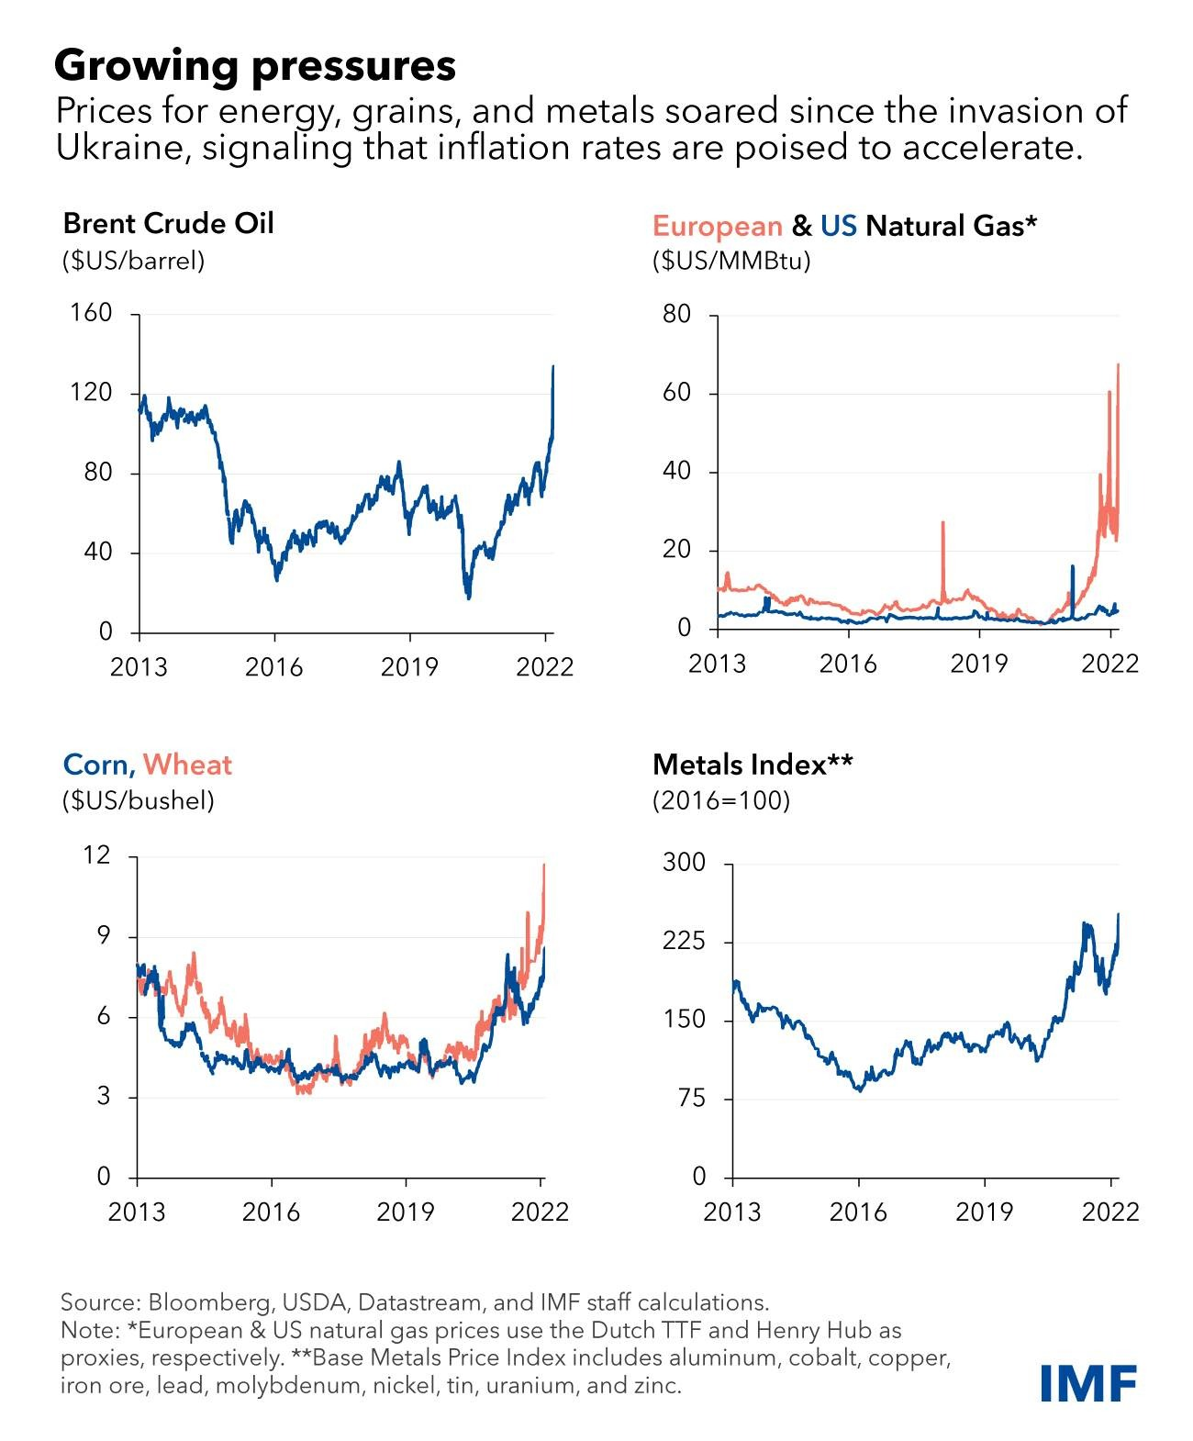
05. Investigate how the conflict has impacted global energy markets
The Russia-Ukraine war conflict has significantly affected the global energy market.
Disruptions in energy supply routes and damaged infrastructure have impacted Russian energy exports.
European countries, heavily reliant on Russian natural gas via Ukraine, have faced supply disruptions. Geopolitical tensions and supply disruptions have led to increased volatility in global energy prices.
The conflict highlights the importance of diversifying energy sources and promoting energy security.
Ongoing efforts to reduce reliance on Russian natural gas through diversification and renewable energy are crucial. Geopolitical stability remains a key factor in maintaining a stable global energy market.

Slide 8
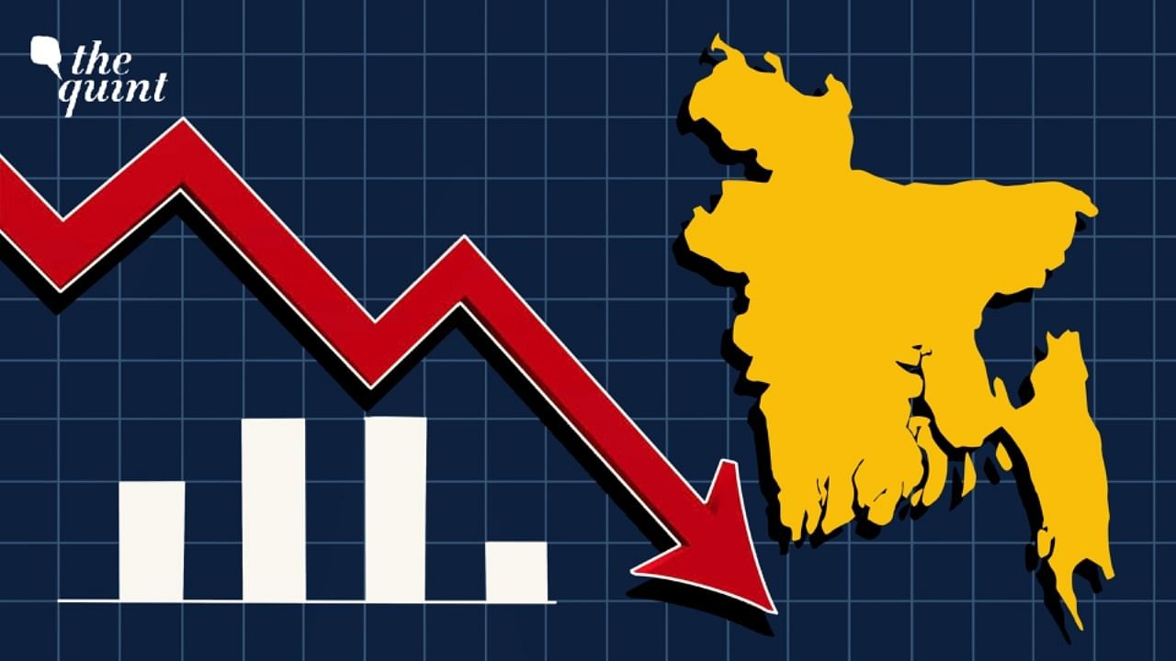
05. Impact on Bangladesh’s Economy
Export :

Slide 9
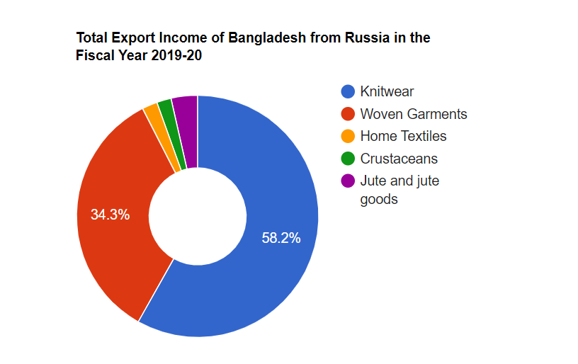
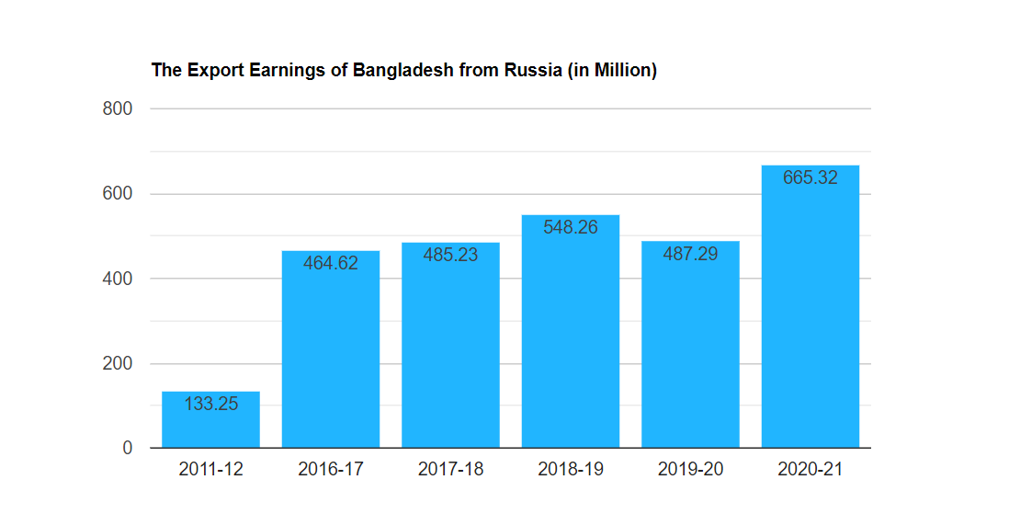
05. Impact on Bangladesh’s Economy
Export :
58.2%
34.3%
In million
2%
1.9%
3.5%

Slide 10
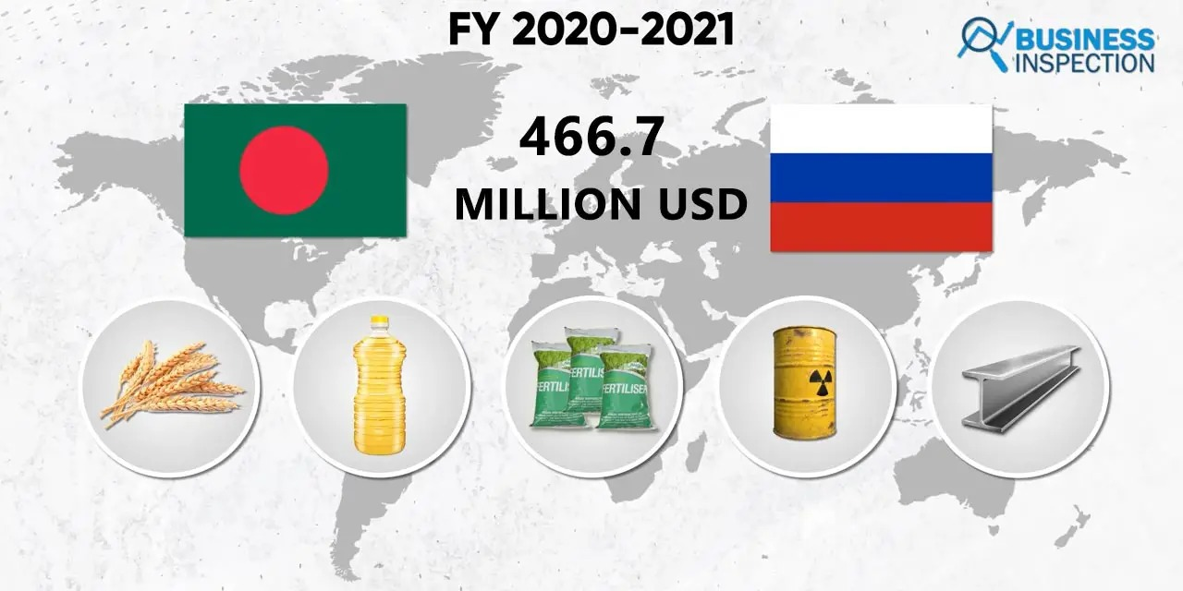
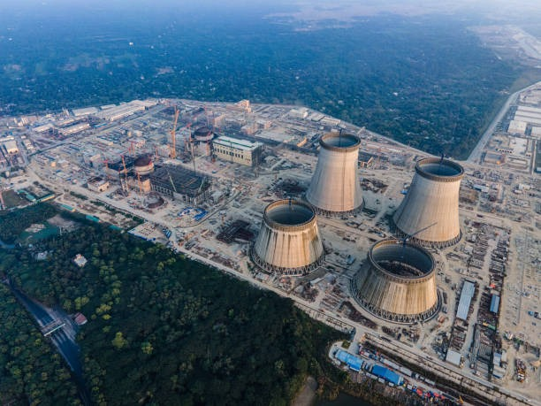
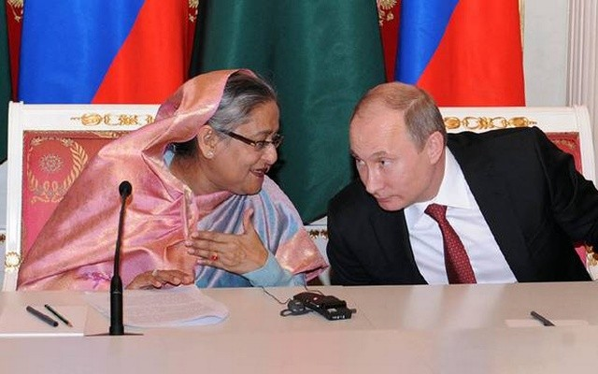
05. Impact on Bangladesh’s Economy
Import:
Development Project

Slide 11


Thanks!
Do you have any questions?
Say
No
TO War
youremail@freepik.com
+91 620 421 838
yourwebsite.com
Please keep this slide for attribution

